Slide 1
High School Security
Review the preliminary plans
Waiting for cost estimates from
Ingersol Rand on door hardware, electronics and security
Waiting for Cost estimates from Eckman on door replacements as required

Slide 2
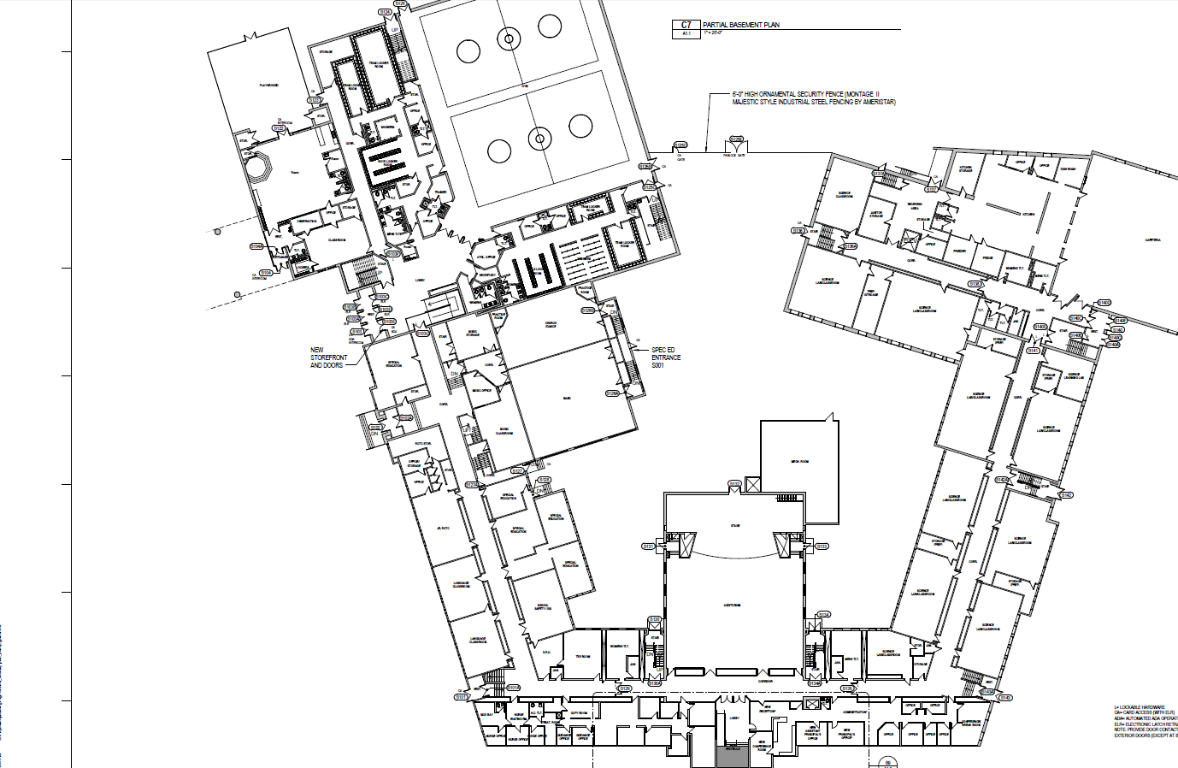

Slide 5
District |  | with contingency
Interior door locks,District | $ 184,000 | $ 220,800
Spaulding High School
General Conditions | $ 35,000
Insurances | $ 5,200
CM Contingency | $ 30,000
CM Fee | $ 24,000
Site Construction | $ 72,800
Masonry, Metals, Woods and Plastics | $ 28,200
Doors and Windows | $ 98,200
Finishes | $ 39,100
Mechanical | $ 23,200
Electrical | $ 32,700
Total Construction (Eckman Estimate) | $ 388,400 | $ 466,080
Door Hardware and materials | $ 150,000 | $ 180,000
Electronic Latching | $ 68,830 | $ 82,596
Cameras and Access control | $ 57,077 | $ 68,492
Architect fees | $ 60,000 | $ 72,000
 | $ 908,307 | $ 1,089,968
LGC Surplus | $ 807,000

Slide 6
Additional Security Needs
High School
Bleacher upgrades | $ 12,425.00
3M Book check library system | $ 3,700.00
Rochester Middle School
Intercom system upgrade | $ 8,500.00
Generator 50/50 grant phase 1 of 2 | $ 112,000.00
McClelland School
Intercom system upgrade | $ 4,000.00
Chamberlain Street
Card Reader-Kindergarten entrance | $ 3,500.00
District
Fire Alarm Panels 3 schools | $ 50,000.00
replacement parts may not be available
if there is a failure at a school
Asbestos Abatement (not critical) | $ 75,000.00
Total | $ 269,125.00

